Slide 1
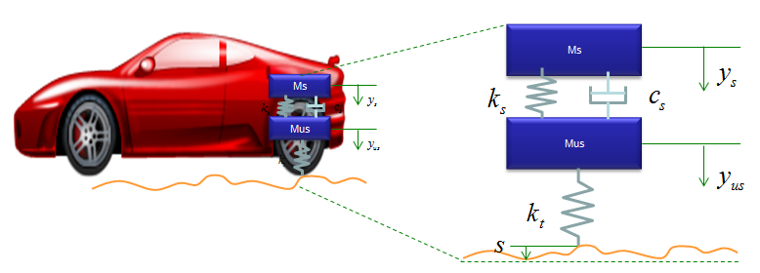
INTRODUCTION: WHAT’S SYSTEM MODELIING AND WHY?
System modeling is used to map the reality (real dynamic system such as a car) into a set of simplified equations (model).
A system model is a set of governing mathematical equations which describe the model's dynamical behavior
http://www.sharetechnote.com/html/DE_Modeling_Example_SpringMass.html

Slide 2
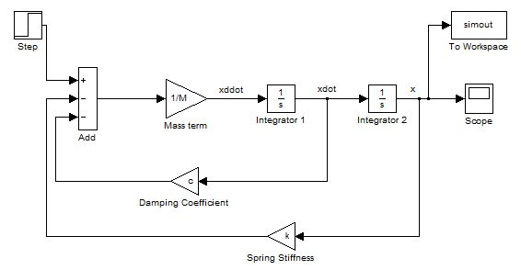
INTRODUCTION: WHAT’S SYSTEM MODELIING AND WHY?
Once you have a governing mathematical equations, you can then simulate the system and assess its performance
MATLAB/Simulink is a powerful tool to simulate these systems.
https://www.mathworks.com/matlabcentral/answers/31344-simulink-mass-spring-damper-system-why-offset-in-steady-state-value
http://www.sharetechnote.com/html/DE_Modeling_Example_SpringMass.html

Slide 3

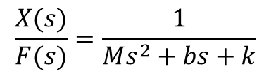
INTRODUCTION: SIMPLE EXAMPLE
Attach springs to your feet and start jumping, your body acts as a mass and springs will compress and stores the energy, and then it releases that energy back onto mass.
You keep jumping and bouncing back until energy is dissipated by friction.
A damper is a device that resists the springs motion and dissipate the energy
With damper, you jump and don’t bounce back because energy stored and released by the spring are absorbed by the damper.
Example: car’s suspension. The mass is the “sprung mass” (chassis), the spring is the coil, and the damper is the shock absorber.
$$\frac{X(s)}{F(s)}=\frac{1}{Ms^{2}+bs+k}$$
https://commons.wikimedia.org/wiki/File:SR-SDoF.gif
https://www.dreamstime.com/royalty-free-stock-photo-spring-ahead-illustration-depicts-man-giant-springs-attached-to-his-shoes-image38664255

Slide 4
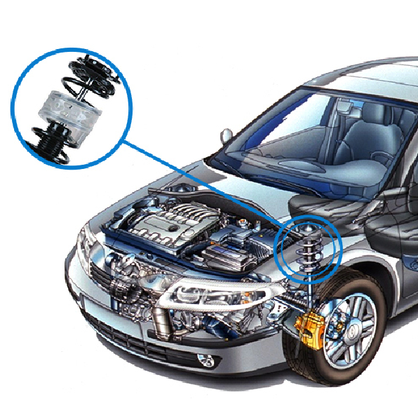
INTRODUCTION: MASS SPRING DAMER SYSTEM
SPRING & DAMPER
NO DAMPER
https://www.maplesoft.com/applications/view.aspx?sid=3926&view=html

